Slide 1
PET PHOTOGRAPHY

Slide 2
Equipment
24-70mm f/2.8 is a good choice.
A bit of zoom lets you stay back far enough that you are not getting in the pet’s face,
and also so you can be less obtrusive
(especially for cats).
Forget the tripod.
You need to be flexible.

Slide 3
A FEW TIPS
First:
Get down to the level of the pet,
rather than standing and looking down
at him or her.

Slide 4
Second:
DON’T USE FLASH!!
(That should probably be first.)
Aperture Priority is a good setting to give a shallow depth of field—try f2 for starters.
ISO of 400-800.
Set White Balance for the available light.
Use window light where possible, or turn on some extra lights indoors if necessary.

Slide 5
Third:
Pets don’t have the same view as people do
of having their portrait taken,
so don’t expect to get the perfect shot immediately, or even soon.
Spend time, first letting the pet (if not yours) get used to you, and take a lot of photos.

Slide 6
Starting with pet cats--

Slide 7
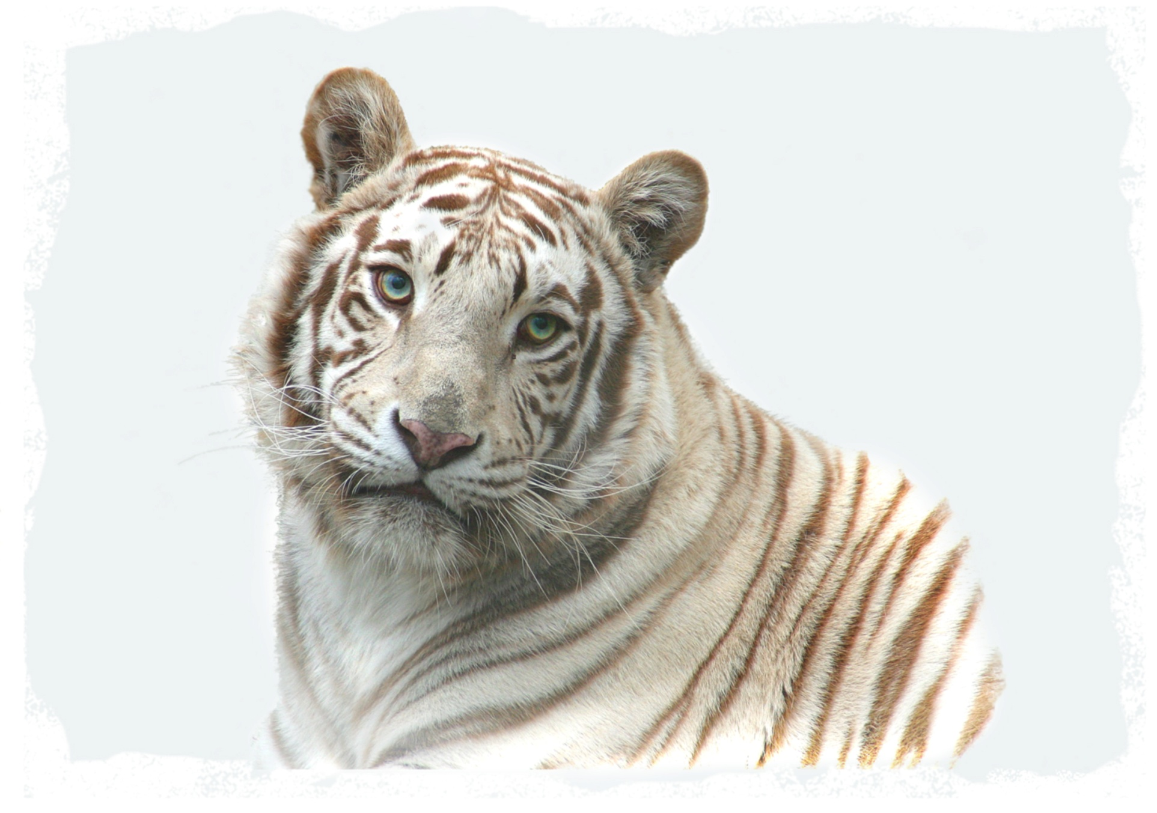

Slide 8
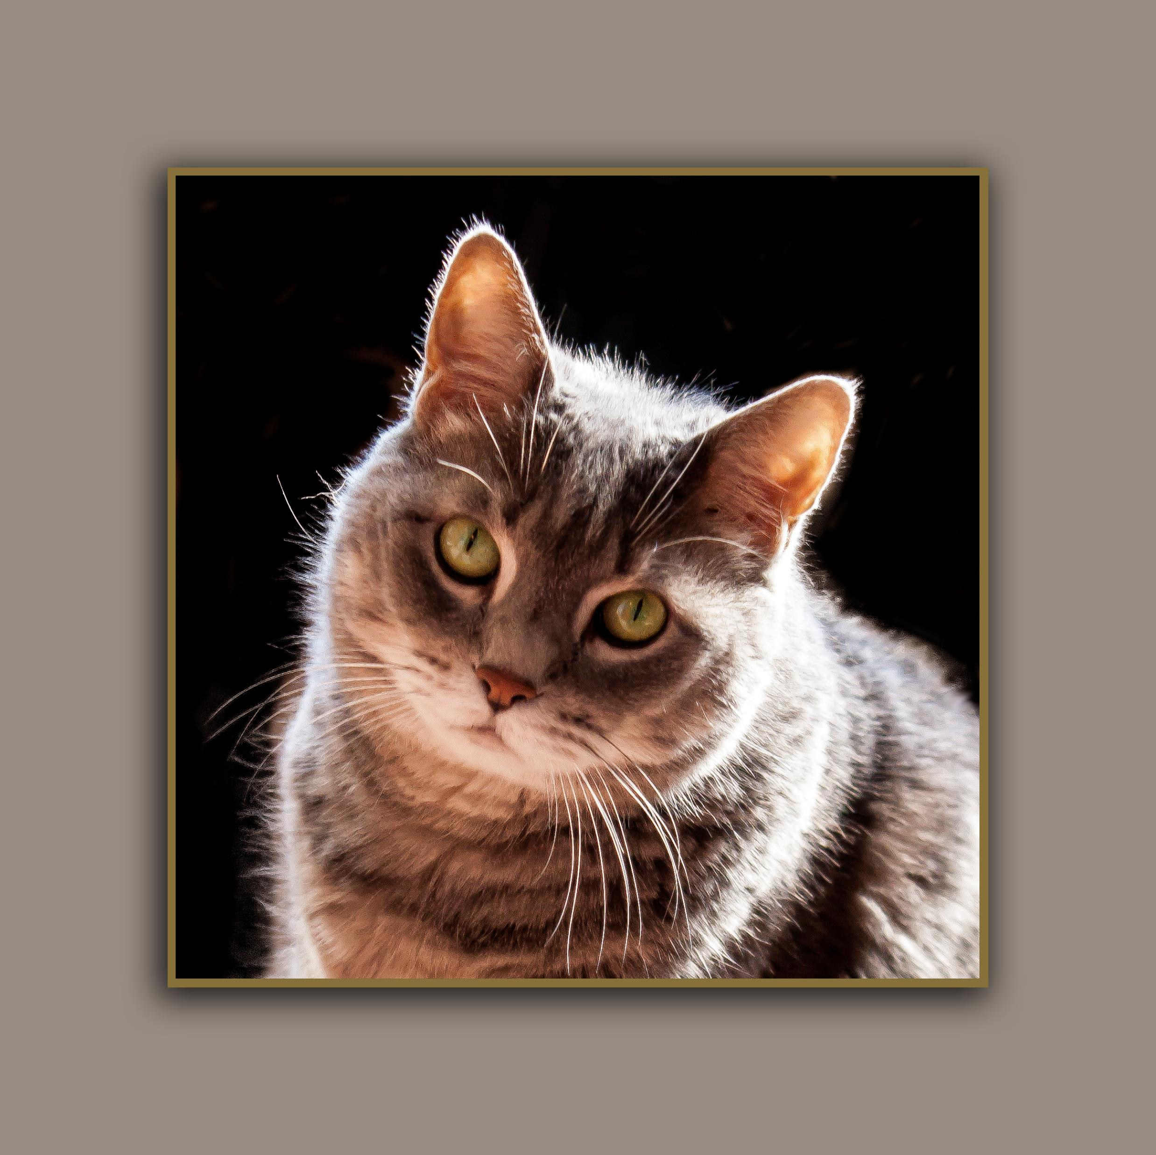
Okay,
starting with smaller cats
It helps to pretend for awhile that you’re not really interested in the cat at all. Then they may become more interested in you.
This is, of course, different from dogs.

Slide 9
It’s always best to
Photograph cats
In their home environment, where they feel comfortable.
a patch of sun
is helpful.

Slide 10
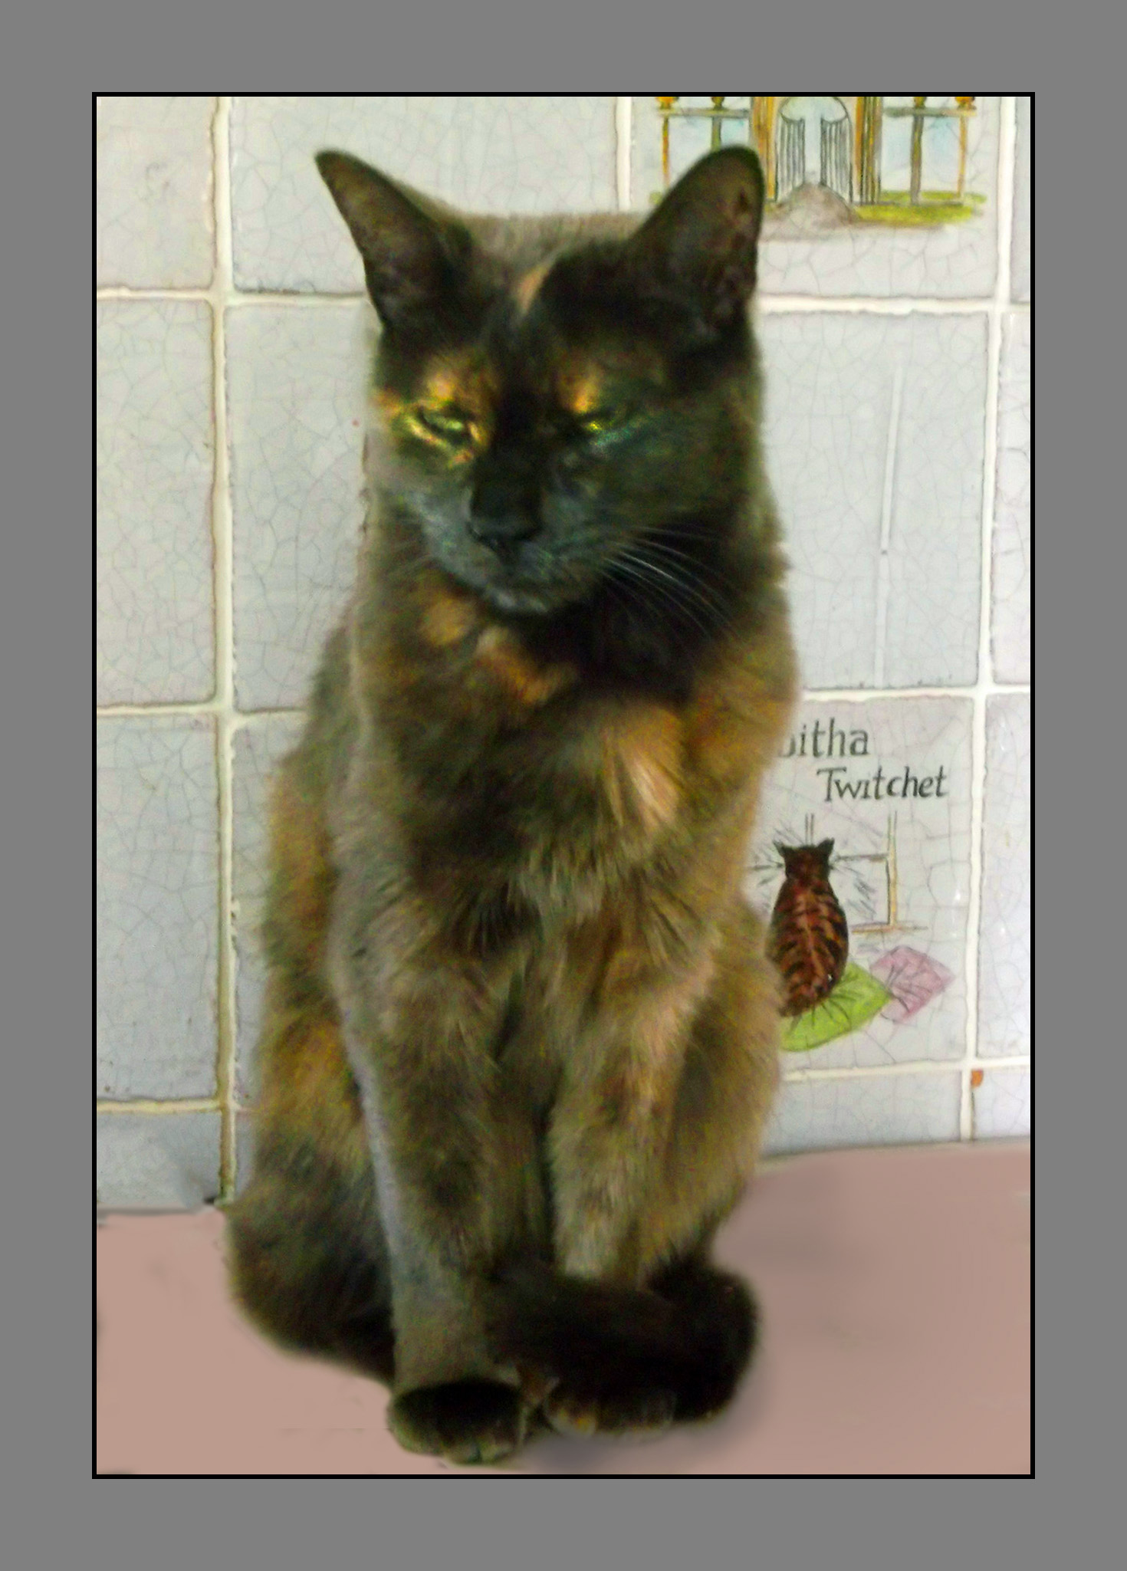
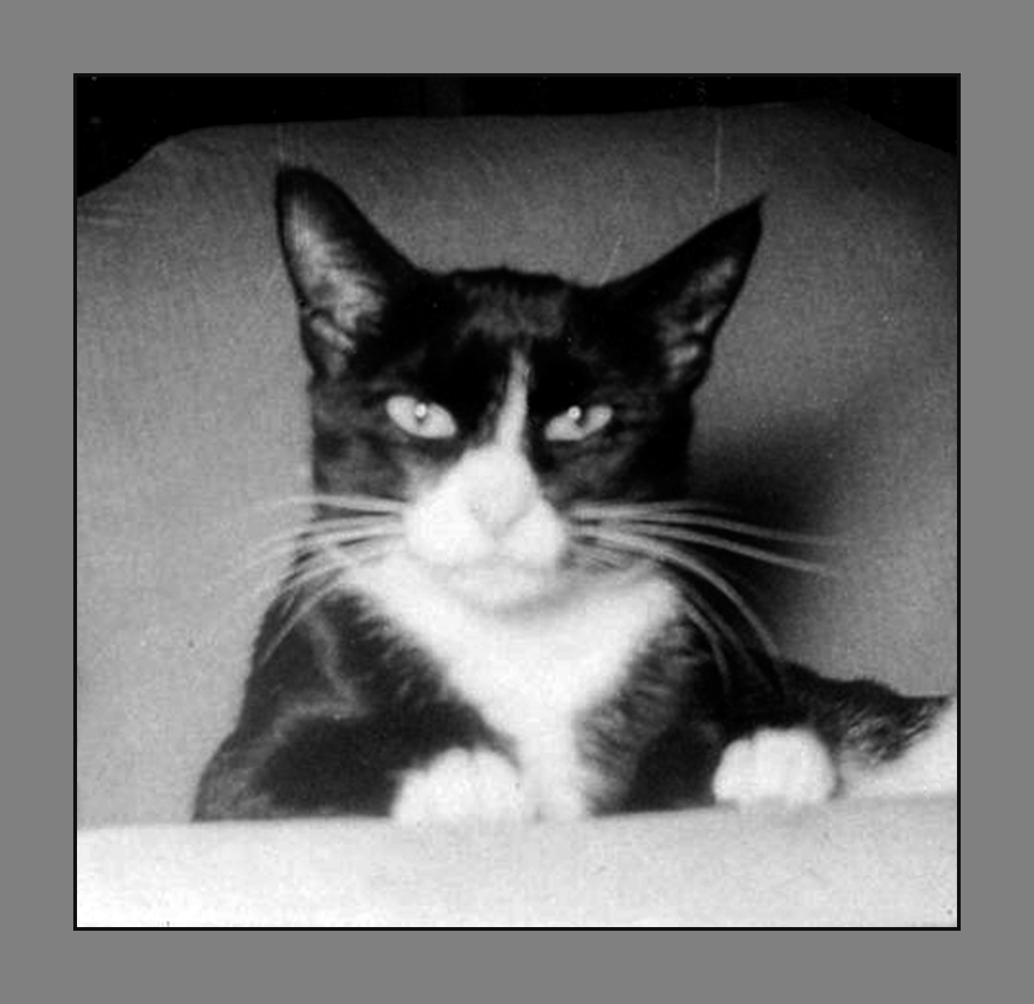
They don’t have to be looking at you.
Myrtle wandered around and got up on a counter, making things easier.
Here’s looking at you.

Slide 11
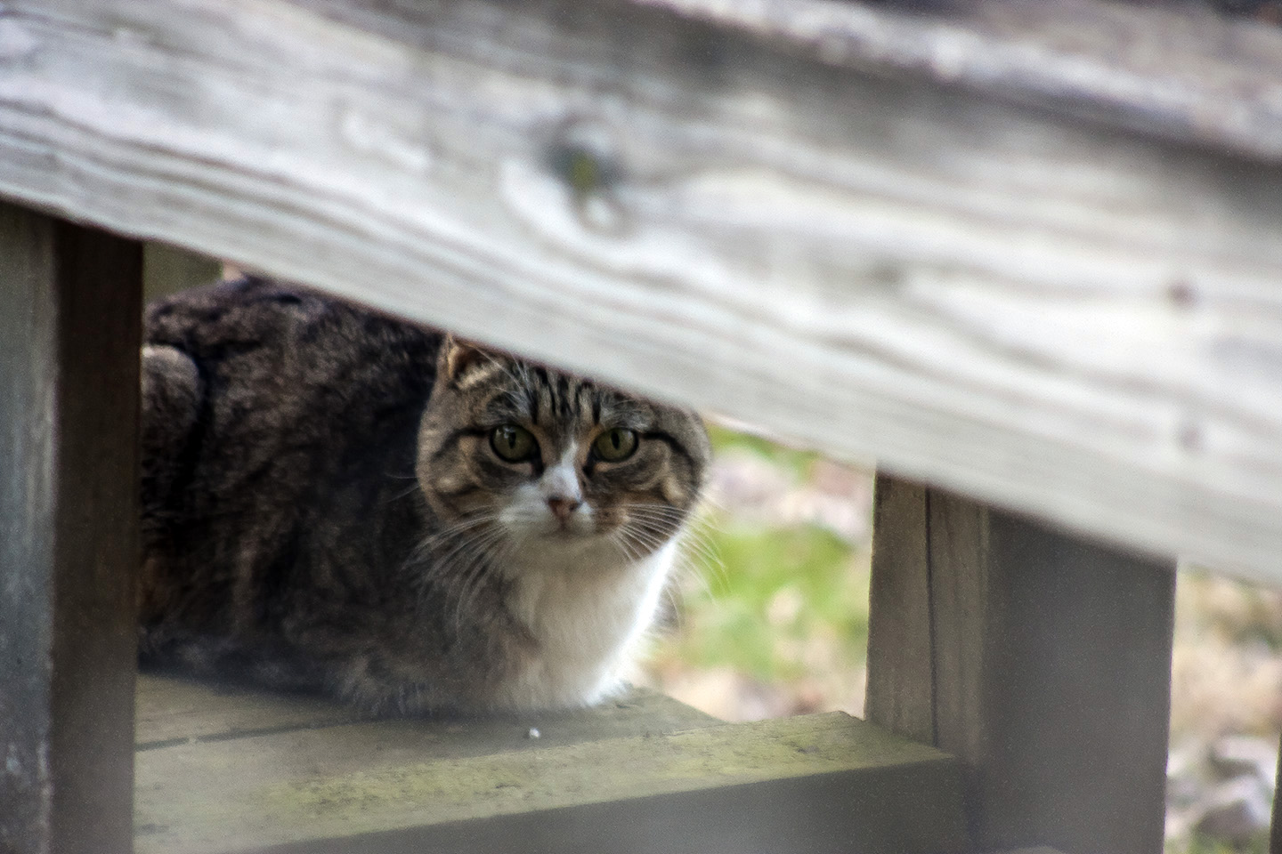
Photographing feral cats has its challenges.

Slide 12
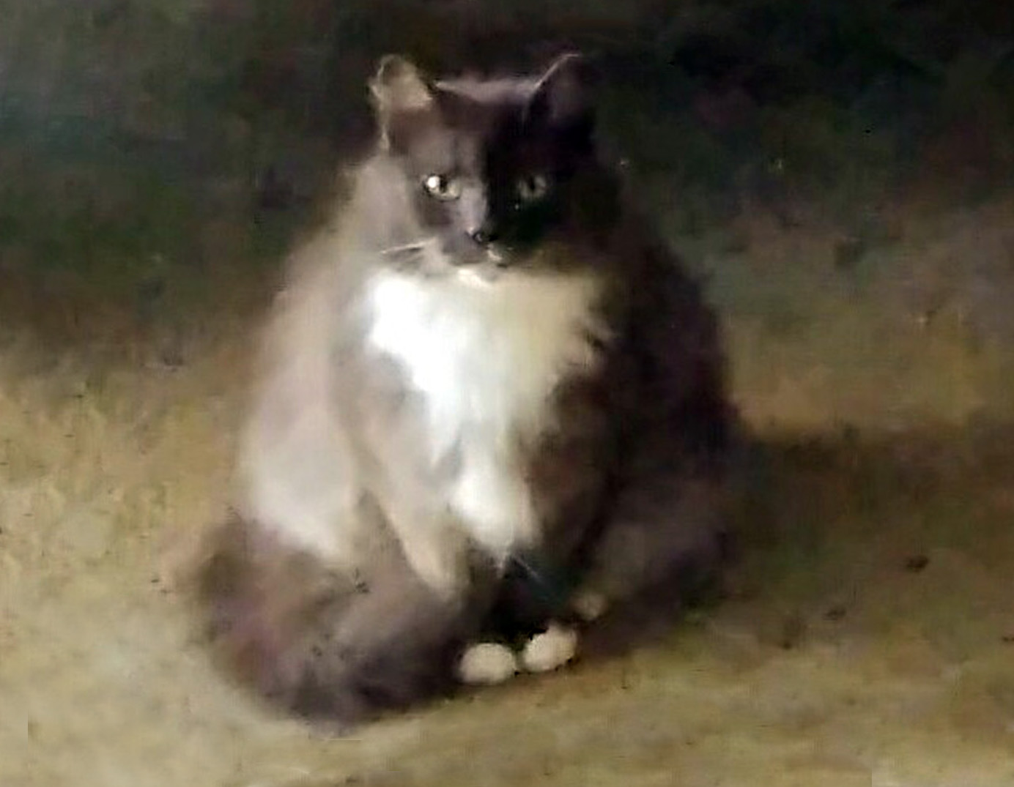
But if you keep your camera near the kitchen door,
and the cat is very hungry,
you just might get lucky.

Slide 13
DOGS
Generally easier than cats for portraits.
The home environment is still best,
but not as important as with cats.
Outdoors can work well.
Allow time to let the dog
(if not yours) get used to you.
For very friendly dogs you may instead have to wait for the dog to have forgotten you!

Slide 14
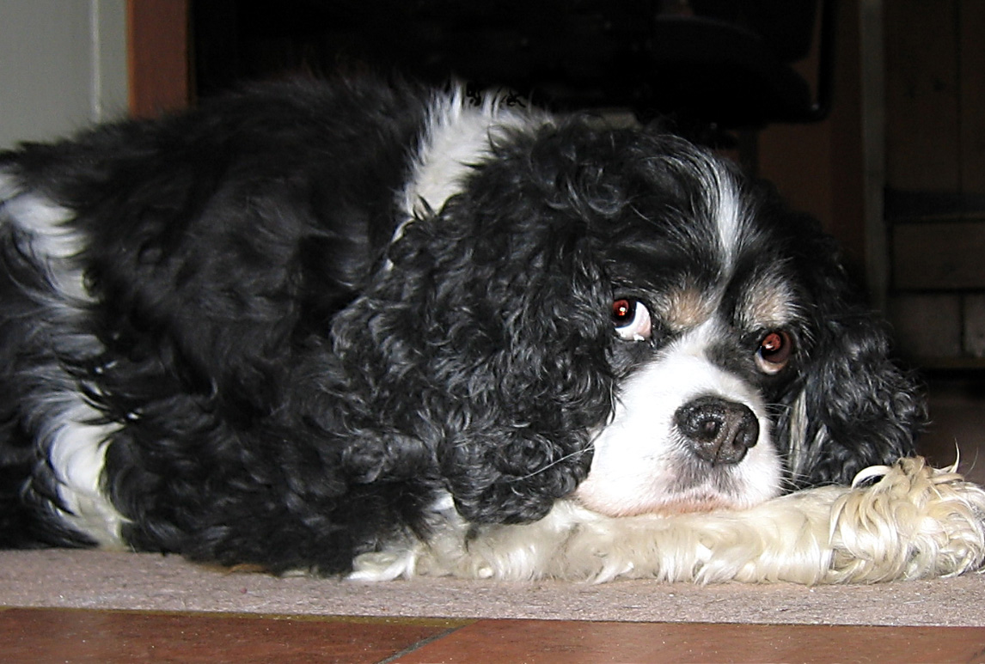
Talk about getting down on their level!

Slide 15
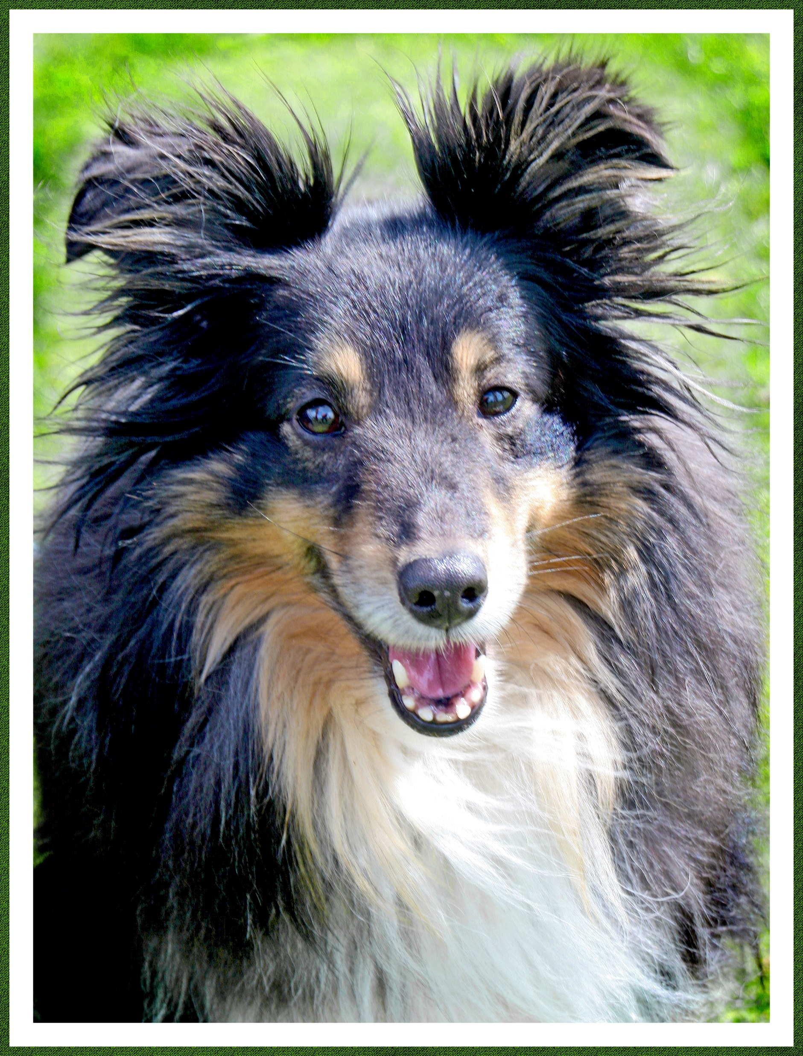
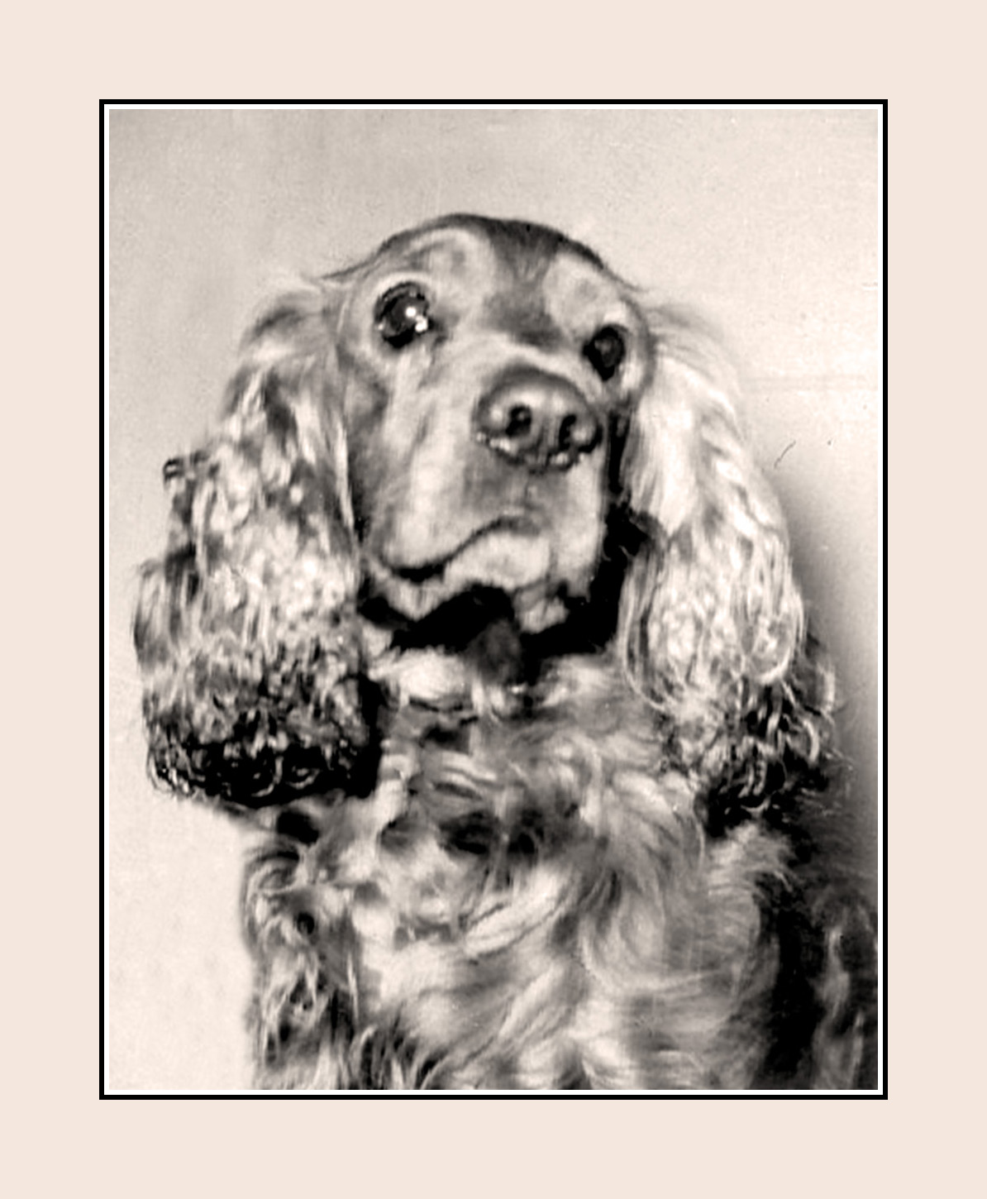
Willow was sitting next to her owner on the lawn.
Roy wondered what on earth I was doing.

Slide 16
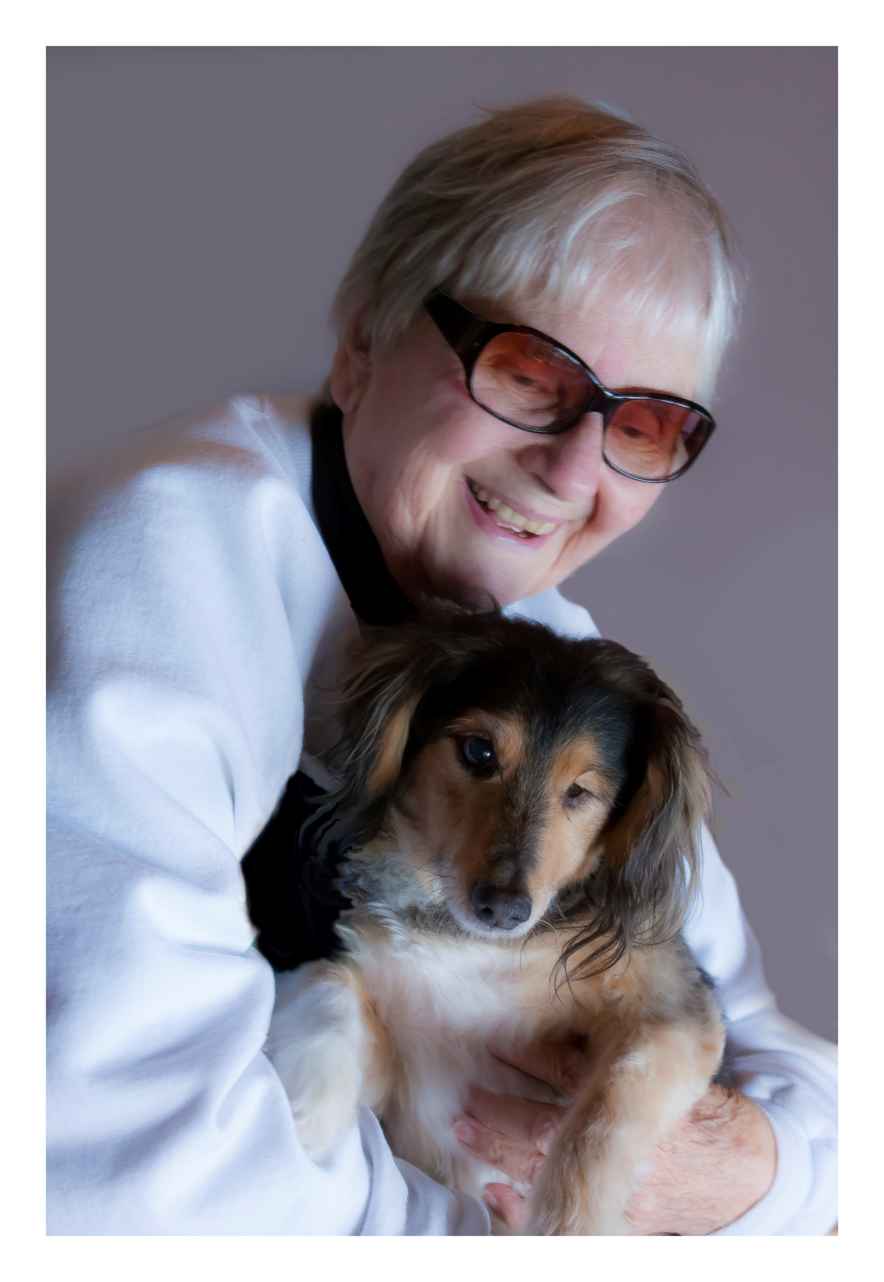
Happy at home
A two-fer

Slide 17
My niece and I found an especially attractive location and Earwig agreed to stay put while I took several photos.

Slide 18
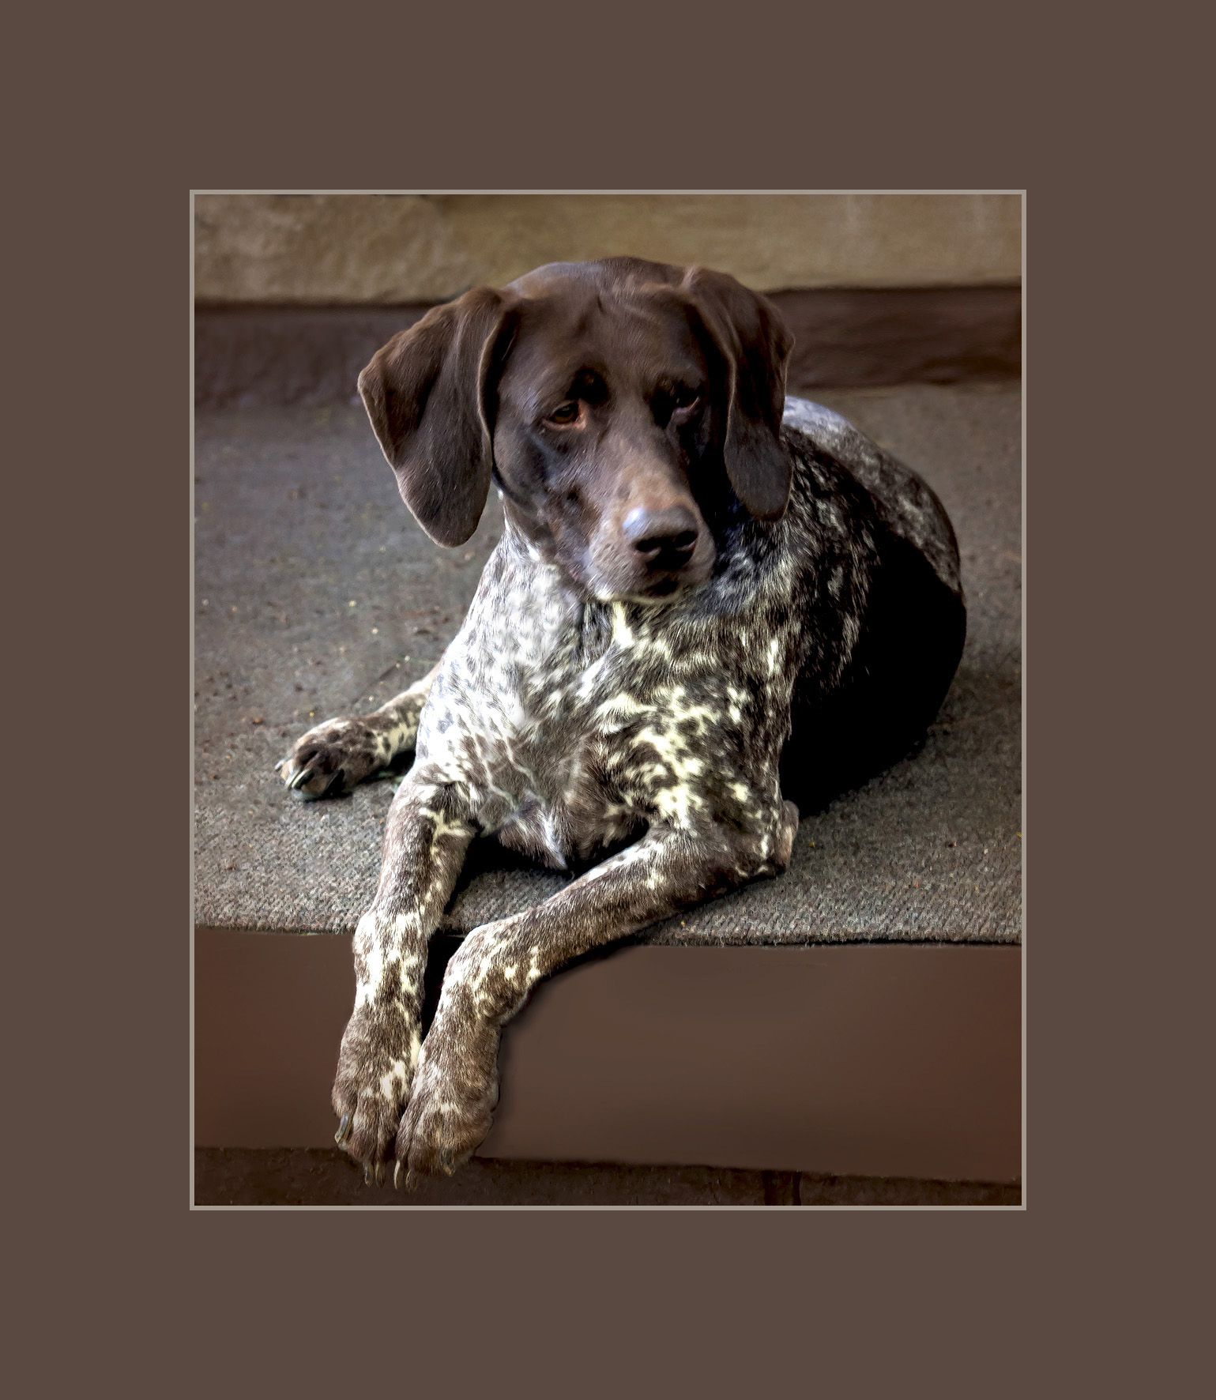
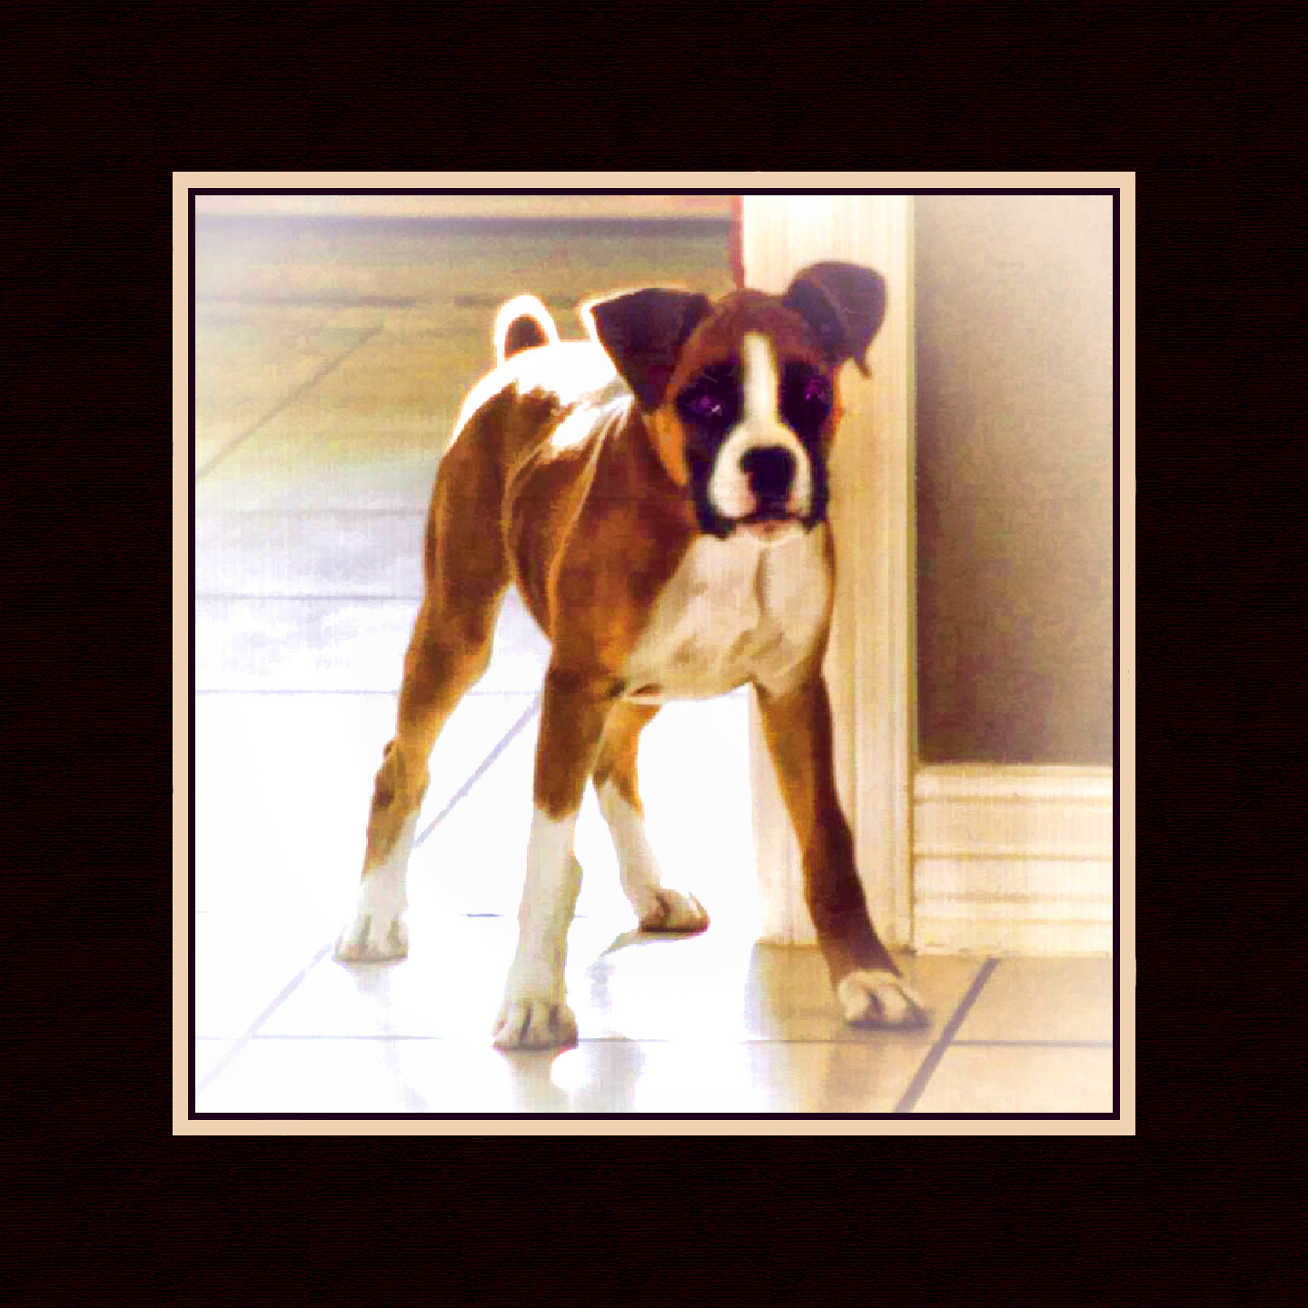
Flicka and Dixie, happenstance,but still pretty good.
Again, you want to get down on their level, or close to it.

Slide 19
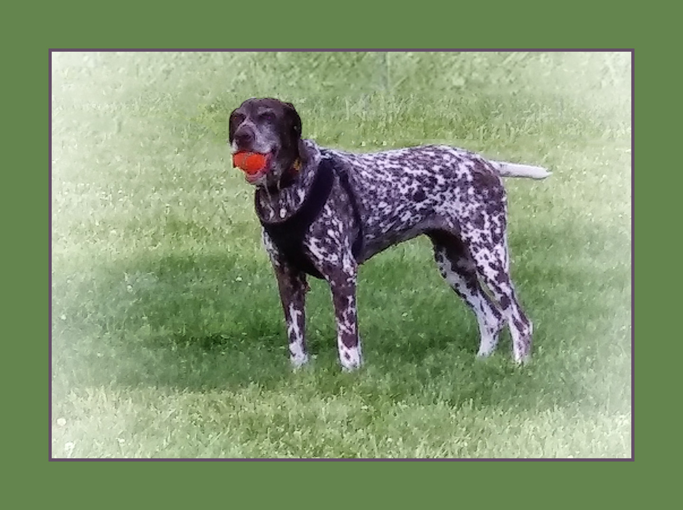
A “character shot.”
Nikki just won’t let go of that ball!
Ideally, the eyes should show up a bit more brightly than they do here—something to watch for and fix if possible in post-processing.

Slide 20
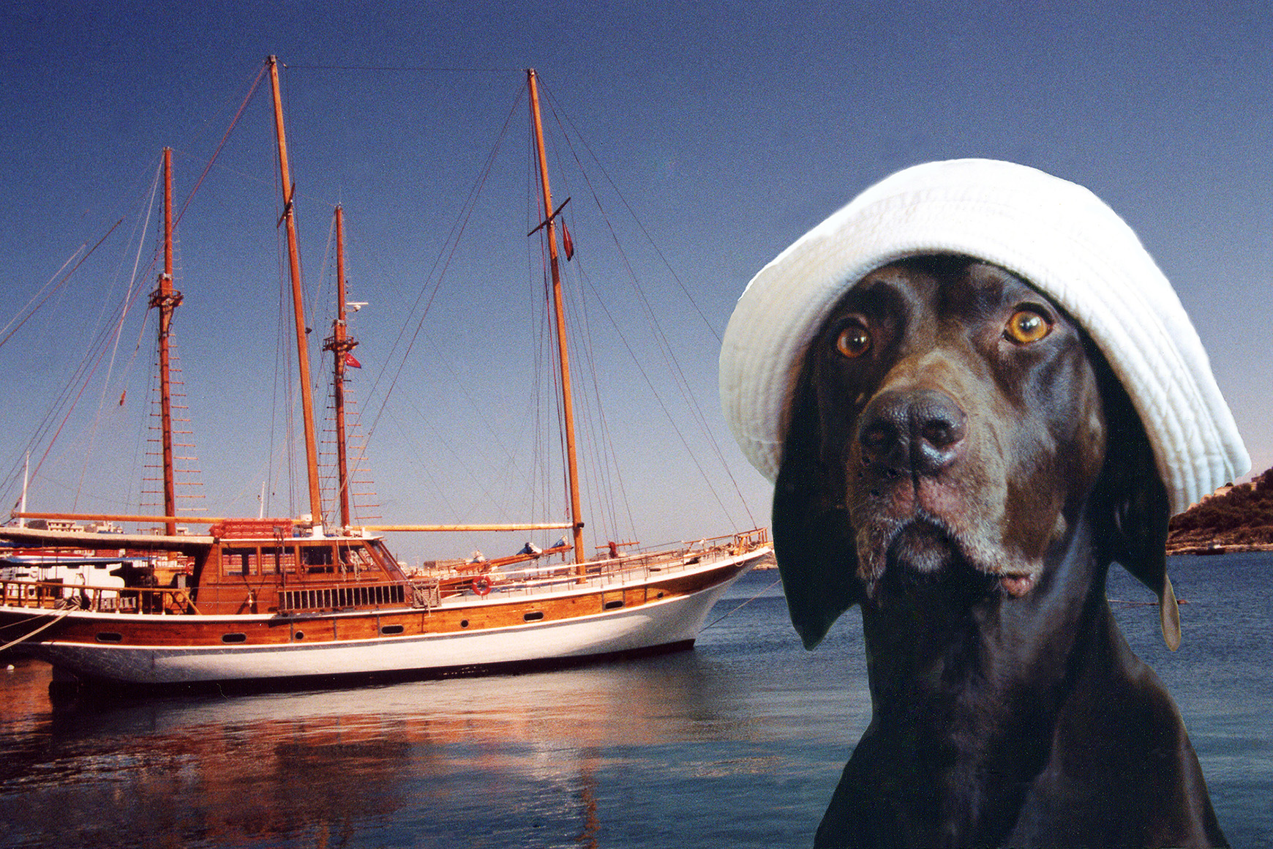
And just for fun, Finney in some of her hats.

Slide 21
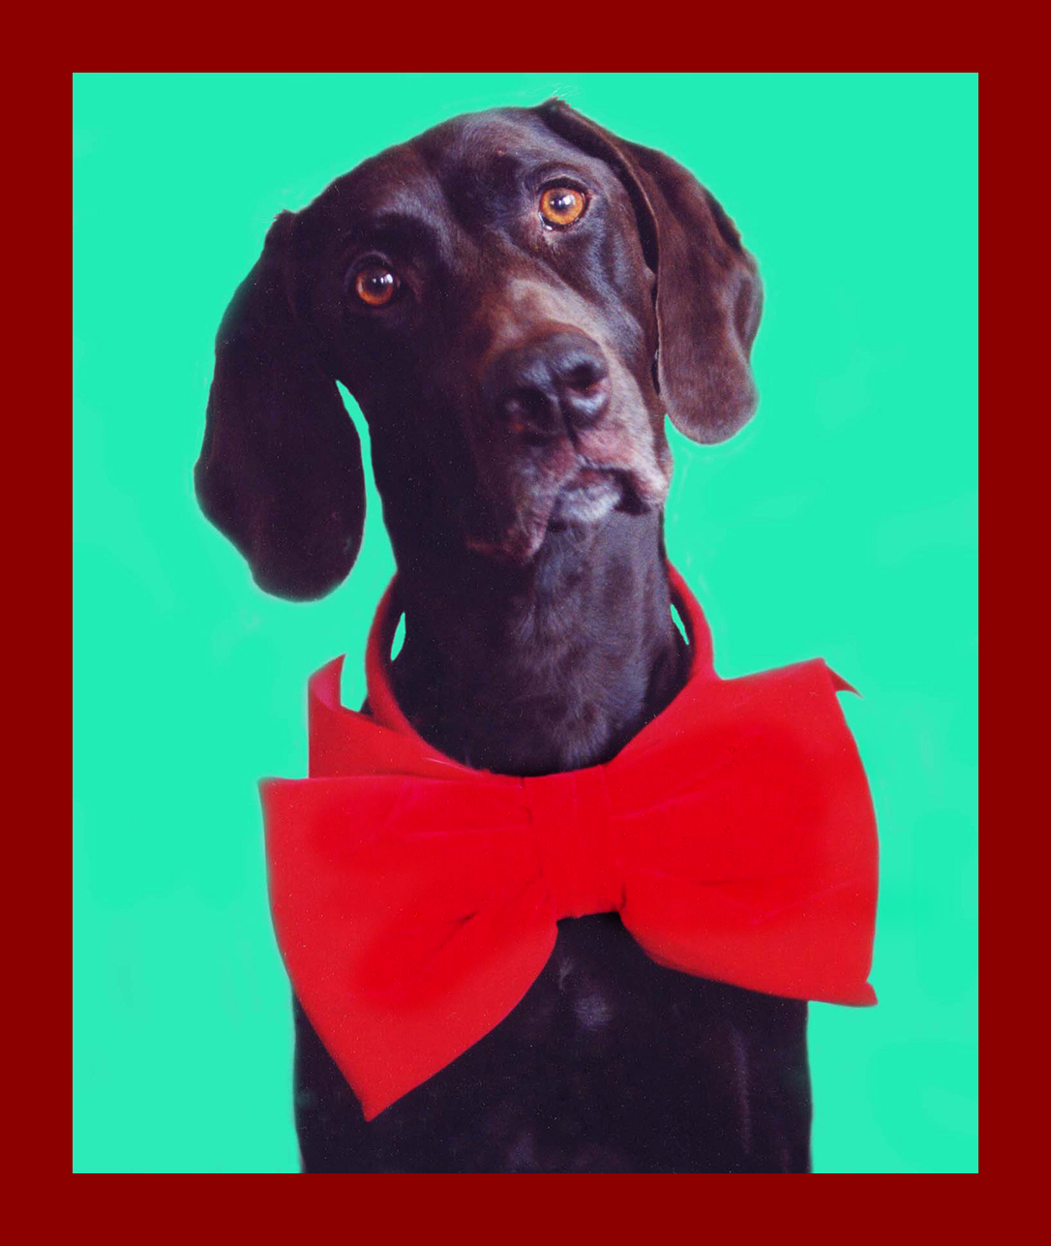
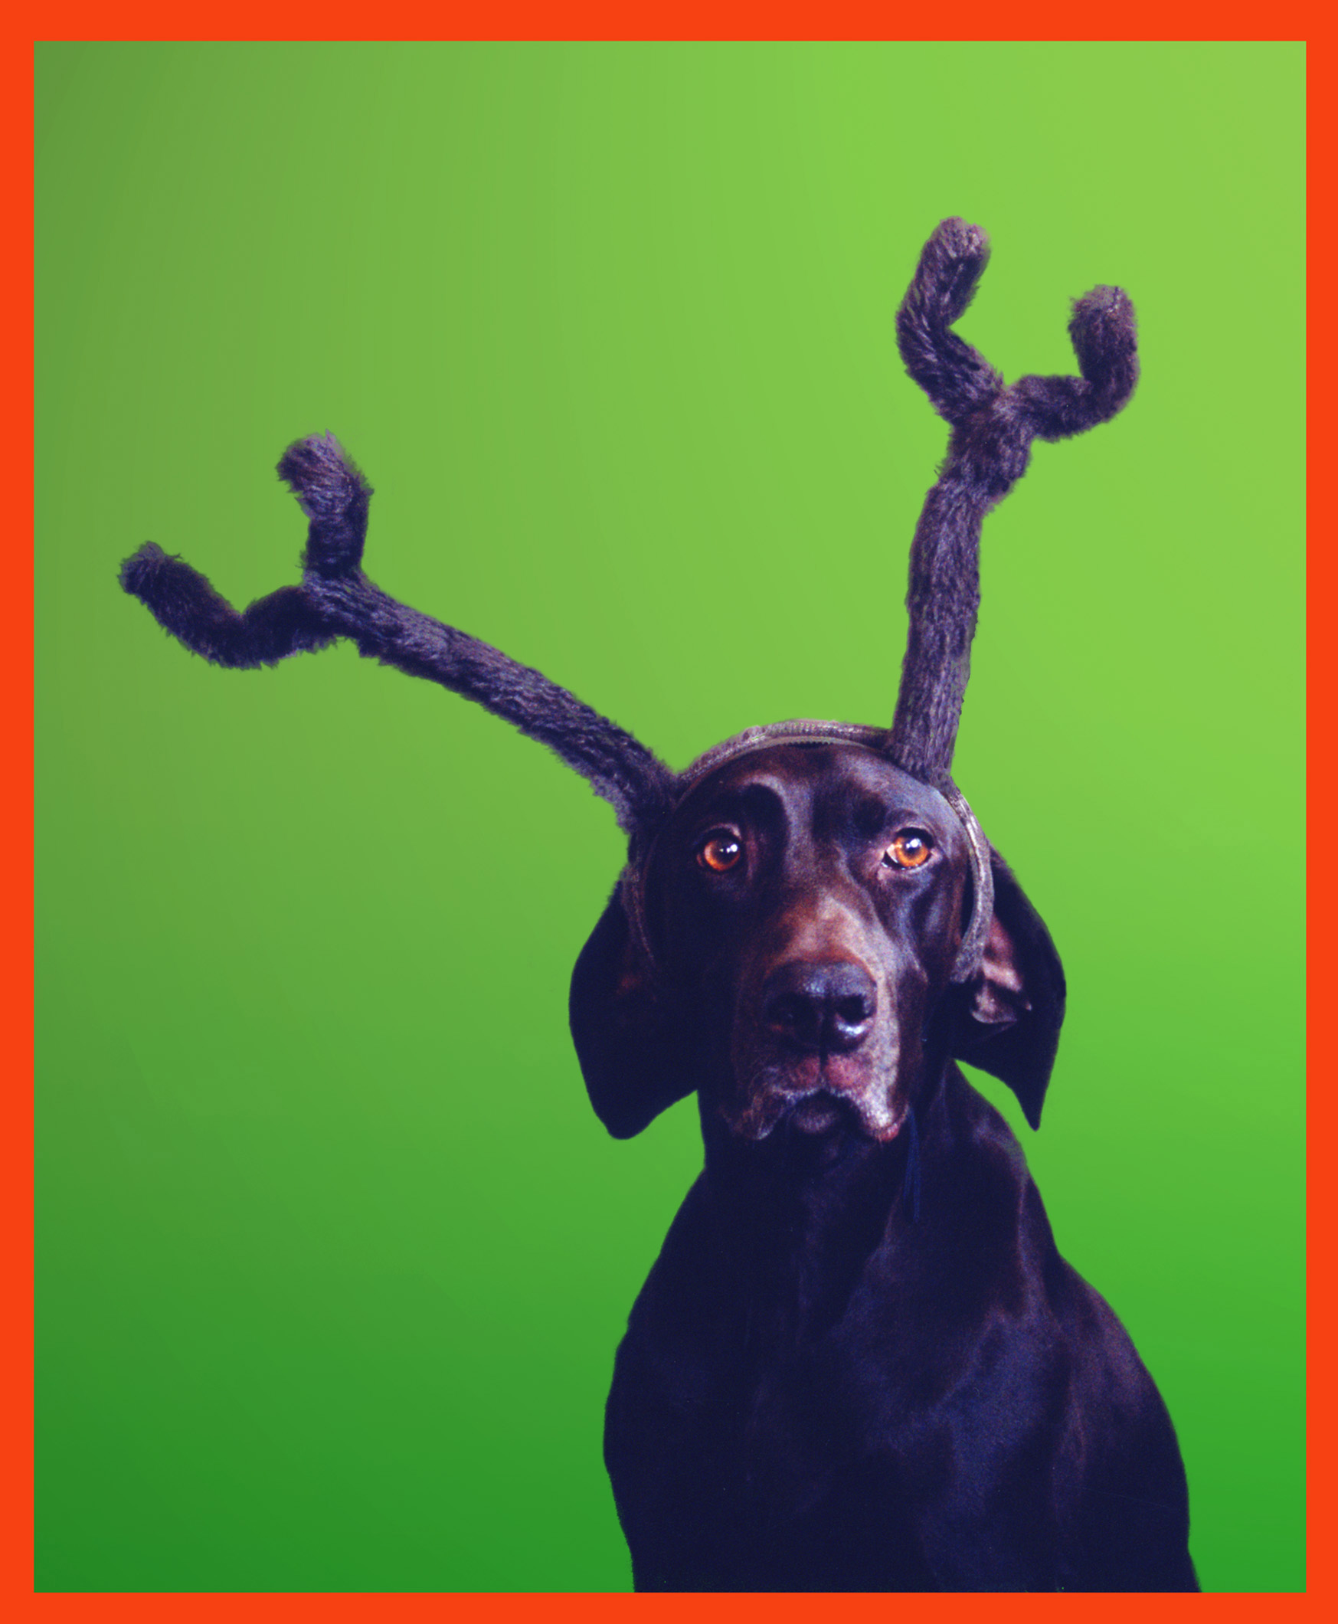
Christmas
Cards!

Slide 22
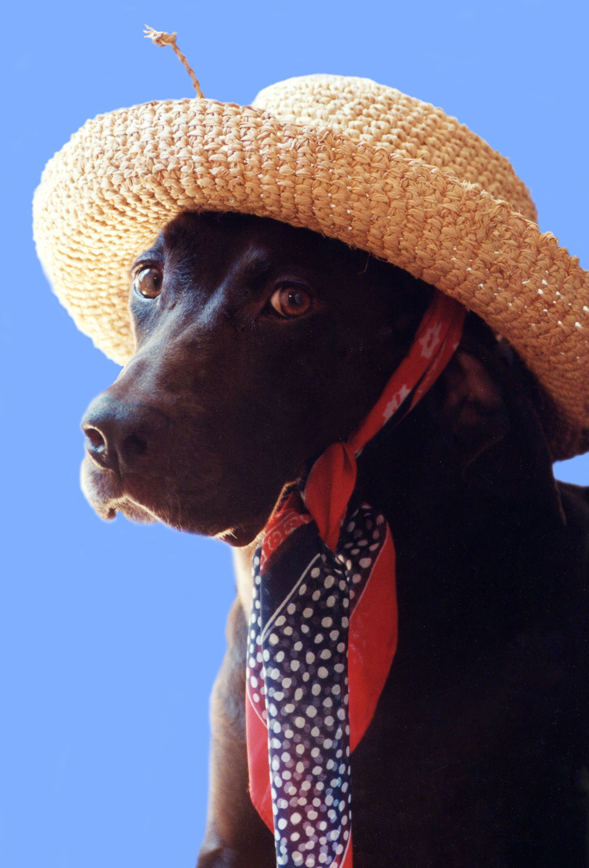
Or just for fun.
That’s it. Thanks for watching.

